Slide 1
People aged >50 years living with HIV
VIIV/DTGP/0003/15b
Date of prep: July 2015
TIVICAY® Prescribing Information available here
TRIUMEQ® Prescribing Information available here

Slide 2
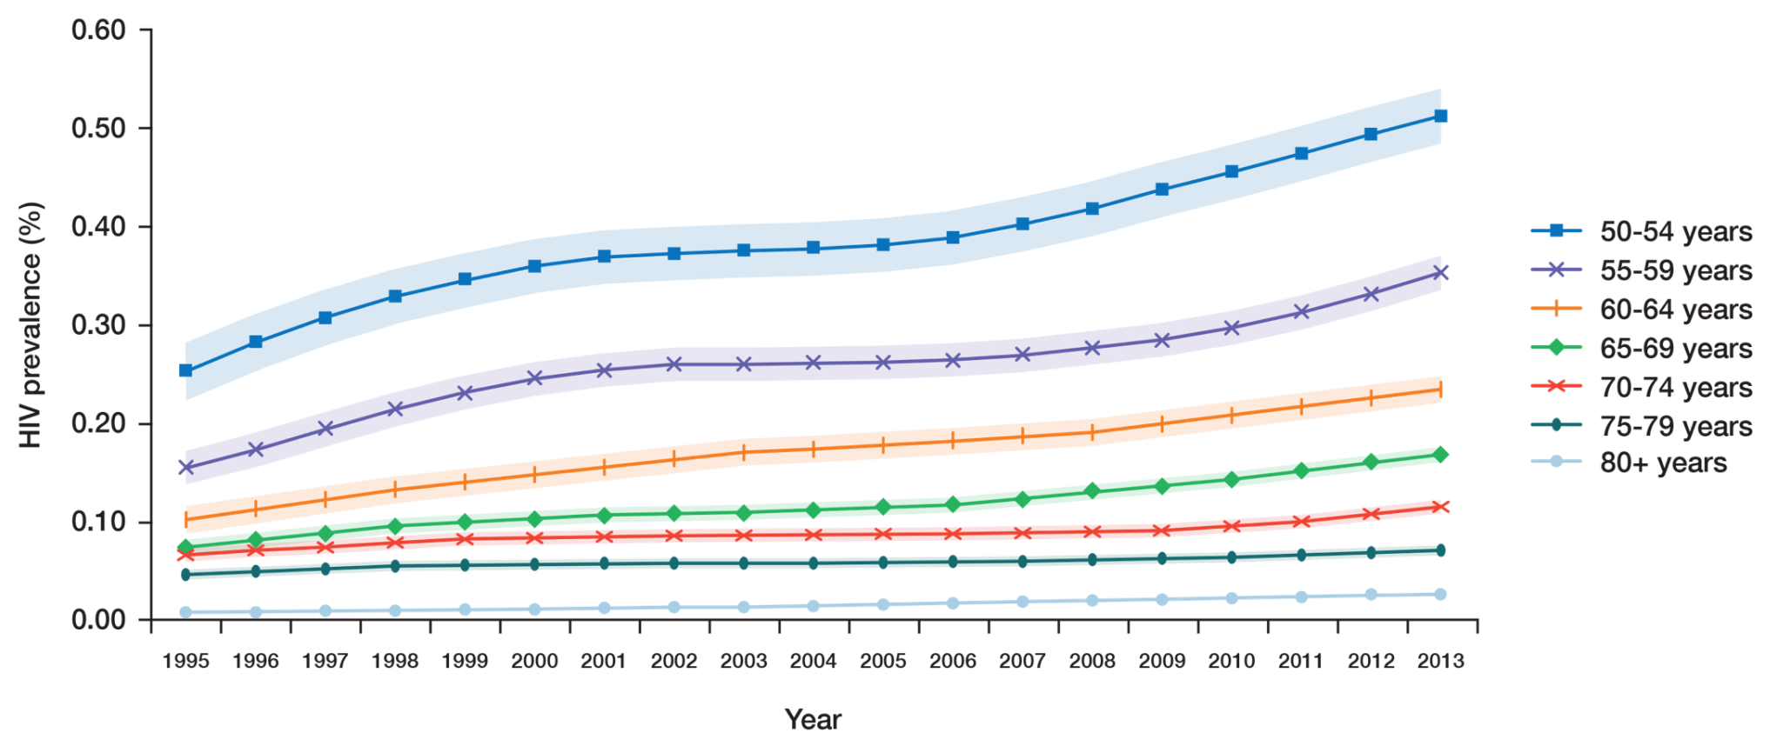
Global estimates of HIV prevalence of people aged 50 years and over
An estimated 4.2 million people aged 50 years and older are living with HIV¹
This number has been steadily increasing since 1995¹
In the US, more than half of all people living with HIV will be over 50 years of age by 2015²
1. Mahy M et al. AIDS 2014; 28(Suppl 4): S453-459
2. Greene M et al. JAMA 2013;309:1397-1405

Slide 3
Key factors in treating older patients with HIV
HIV patients may be at greater risk of the diseases of ageing
Management of co-morbidities
Health maintenance and prevention of modifiable risk factors
Risk for polypharmacy and drug-drug interactions
Greene M et al. JAMA 2013;309:1397-1405

Slide 4
An increasingly older population with HIV is associated with increasing treatment costs
Total | $791 | $843 | $792 | $833 | $836 | $928 | $949 | $979 | $1088 | $1128 | $1124 | $1140
≤50 years | $776 | $818 | $750 | $793 | $800 | $871 | $895 | $911 | $966 | $1077 | $1072 | $1075
>50 years | $925 | $1033 | $1068 | $1076 | $1164 | $1166 | $1158 | $1248 | $1317 | $1292 | $1284 | $1325
Adapted from,Krentz HB, Gill MJ. HIV Med 2015; 16: 38-47

Slide 5
Polypharmacy
Defined as taking 5 or more chronic medications¹
Associated with:
Adverse drug events^{1,2}
Drug interactions^{1,2}
Inappropriate medication use¹
Delirium, falls and fractures¹
Poor adherence¹
5+
1. Edelman EJ et al. Drugs Aging 2013; 30: 613-628
2. Nachega JB et al. AIDS 2012; 26 (Suppl 1); S39-S53

Slide 6
Age-related physiological changes and their pharmacokinetic consequences
Physiological changes in the elderly: | Increased body fat | Decrease in plasma volume | Decrease in total body water | Decrease in extracellular body fluid
Pharmacokinetic consequences: | Increased V and t_{1/2} of lipophilic drugs |  | Increased plasma concentration of hydrophilic drugs
8%
17%
40%
36%
Patients with HIV may be ~14 years older than their chronological age²
1. Klotz Drug Metabolism Reviews, 2009; 41(2): 67–76
2. Rickabaugh TM et al. 2015 PLoS ONE 10(3): e0119201. doi:10.1371/journal.pone.0119201

Slide 7
The proportion of older HIV-infected individuals is increasing
HIV is increasingly seen as a chronic condition, with patients living longer because of advancements in ARV therapy¹
Proportion of patients ≥50 years of age in the French Hospital Database on HIV (FHDH ANRS CO4) by year of follow-up²
45
Men
Women
40
The percentage of HIV-infected men ≥50 years of age increased from 8.5% in 1993 to 42.0% in 2012.
The corresponding figures for women were 6.0% in 1993 and 26.9% in 2012²
35
30
25
50 years of age or older (%)
20
15
10
5
0
1993
1997
2001
2005
2009
2012
Year of follow-up
Median age
34
36
40
42
45
47
(years)
Figure adapted from Costagliola D. Curr Opin HIV AIDS 2014;9:294–301 1. Deeks SG et al. Lancet 2013;382:1525–1533; 2. Costagliola D. Curr Opin HIV AIDS 2014;9:294–301

Slide 8
Older HIV patients may be at increased risk of DRUG-DRUG INTERACTIONS
The risk of potential drug-drug interactions is increased in older patients who take more drugs than their younger HIV-infected counterparts
50
<50 years
≥50 years
Data from the Swiss HIV cohort found that older patients:
Were more likely to receive at least one non-ARV medication than younger patients (82% vs 61%, P<0.001)
Had more frequent potential drug interactions (51% vs 35%, P<0.001)
40
30
Patients (%)
20
10
0
0
1
2
3
4
5
6
7
>8
Number of co-medications
Marzolini C et al. J Antimicrob Chemother 2011;66:2107–2111

Slide 9
Recognition of risk for clinically significant drug interactions (CSDIs)
Only 36% of clinically significant drug interactions were accurately recognised by physicians¹
Effects of failure to identify or to manage HIV CSDIs may be substantial¹
15% of CSDIs had the potential to reduce antiretroviral concentrations¹
Patients with CSDIs may present with unclear symptoms or unexplained laboratory abnormalities¹
Evans-Jones JG et al. Clin Infect Dis 2010; 50(10): 1419-1421

Slide 10
FACTORS INFLUENCING adherence
Once-daily regimen¹⁻³
No requirement for food¹
Low pill burden^{1,4}
Few side effects or toxicities¹
Department of Health and Human Services (DHHS) Panel. Guidelines for the use of antiretroviral agents in HIV-1-infected adults and adolescents. April 2015 Available at: http://aidsinfo.nih.gov/guidelines/html/1/adult-and-adolescent-treatment-guidelines/0 Last accessed June 2015
Parienti JJ et al. Clin Infect Dis 2009; 48: 484-488
Raboud J et al. AIDS Behav 2011; 15: 1397-1409
Nachega JB et al. Clin Infect Dis 2014; 58: 1297-1307

Slide 11
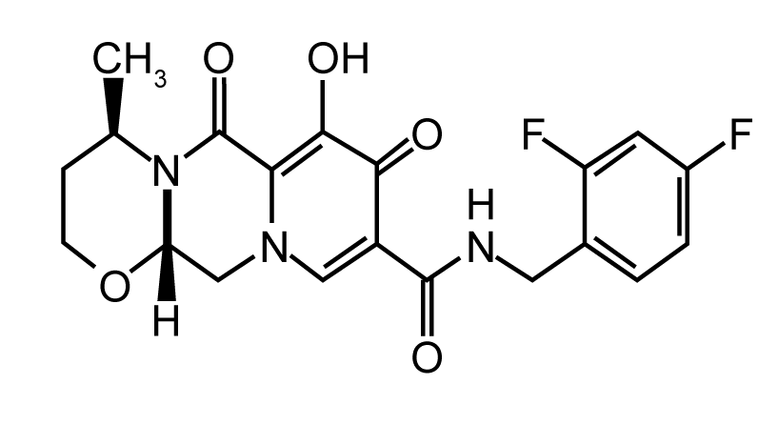
Key characteristics of DOLUTEGRAVIR-BASED REGIMENS
Superior efficacy in 3 out of 4 comparative studies^{1–4}
ü
Convenience beyond once-daily dosing⁵
ü
ü
Favourable tolerability profile^{7–9}
DOLUTEGRAVIR
Booster-free - few clinically significant drug interactions¹⁰
ü
ü
High barrier to resistance^{4–8}
Walmsley S et al. N Engl J Med 2013;369:1807–1818
Clotet B et al. Lancet 2014;383:2222–223
Cahn P et al. Lancet 2013;382:700–708
Raffi F et al. Lancet Infect Dis 2013;13:927–935
Tivicay Summary of Product Characteristics;
Pappa K et al. ICAAC 2014. Abstract H-647a
Walmsley S et al. CROI 2014. Poster 543
Molina J-M et al. Lancet HIV 2015;2:e127–e136
Quercia R et al. Clin Drug Investig 2015;35:211–219
HIV drug interactions charts. Liverpool HIV Pharmacology Group (LHPG), University of Liverpool, UK. Available at http://www.hiv-druginteractions.org (accessed 20/02/2015)

Slide 12
Key characteristics of DOLUTEGRAVIR-BASED REGIMENS
Superior efficacy in 3 out of 4 comparative studies^{1–4}
ü
Convenience beyond once-daily dosing⁵
ü
ü
Favourable tolerability profile^{7–9}
DOLUTEGRAVIR
Booster-free - few clinically significant drug interactions¹⁰
ü
ü
High barrier to resistance^{4–8}
Walmsley S et al. N Engl J Med 2013;369:1807–1818
Clotet B et al. Lancet 2014;383:2222–223
Cahn P et al. Lancet 2013;382:700–708
Raffi F et al. Lancet Infect Dis 2013;13:927–935
Tivicay Summary of Product Characteristics;
Pappa K et al. ICAAC 2014. Abstract H-647a
Walmsley S et al. CROI 2014. Poster 543
Molina J-M et al. Lancet HIV 2015;2:e127–e136
Quercia R et al. Clin Drug Investig 2015;35:211–219
HIV drug interactions charts. Liverpool HIV Pharmacology Group (LHPG), University of Liverpool, UK. Available at http://www.hiv-druginteractions.org (accessed 20/02/2015)

Slide 13
DTG efficacy consistent across ≥50 YEARS OF AGE subgroups in 3 separate studies
<50 | ≥50 |  | <50 | ≥50 |  | <50 | ≥50 |  | <50 | ≥50 |  | <50 | ≥50 |  | <50 | ≥50
EFV/TDF/FTCª |  |  | DTG + ABC/3TC |  |  | DRV/r |  |  | DTG |  |  | RAL |  |  | DTG
SINGLE |  |  |  |  |  | FLAMINGO |  |  |  |  |  | SPRING-2
DTG snapshot efficacy at 96 weeks in <50 and ≥50 years of age subjects
ªDTG treatment with protocol defined NRTI backbone (ABC/3TC or TDF/FTC)
Koteff J et al. 8th IAS Conference on HIV Pathogenesis, Treatment and Prevention 2015. Poster TUPEB261

Slide 14
New SUBGROUP ANALYSIS showS that DTG is effective up to 96 weeks in patients ≥50 YEARS OF AGE
Koteff J et al. 8th IAS Conference on HIV Pathogenesis, Treatment and Prevention 2015. Poster TUPEB261

Slide 15
Key characteristics of DOLUTEGRAVIR-BASED REGIMENS
Superior efficacy in 3 out of 4 comparative studies^{1–4}
ü
Convenience beyond once-daily dosing⁵
ü
ü
Favourable tolerability profile^{7–9}
DOLUTEGRAVIR
Booster-free - few clinically significant drug interactions¹⁰
ü
ü
High barrier to resistance^{4–8}
Walmsley S et al. N Engl J Med 2013;369:1807–1818
Clotet B et al. Lancet 2014;383:2222–223
Cahn P et al. Lancet 2013;382:700–708
Raffi F et al. Lancet Infect Dis 2013;13:927–935
Tivicay Summary of Product Characteristics;
Pappa K et al. ICAAC 2014. Abstract H-647a
Walmsley S et al. CROI 2014. Poster 543
Molina J-M et al. Lancet HIV 2015;2:e127–e136
Quercia R et al. Clin Drug Investig 2015;35:211–219
HIV drug interactions charts. Liverpool HIV Pharmacology Group (LHPG), University of Liverpool, UK. Available at http://www.hiv-druginteractions.org (accessed 20/02/2015)

Slide 16
AEs Grade 2–4 AND Aes LEADING TO withdrawal IN <50 and ≥50 years of age SUBJECTS
AEs grade 2–4
AEs leading to withdrawal
Safety summaries showed comparable grade 2–4 drug related AEs across the ≥50 years of age subgroup, as well as low rates of AEs leading to withdrawals
Koteff J et al. 8th IAS Conference on HIV Pathogenesis, Treatment and Prevention 2015. Poster TUPEB261

Slide 17
DTG + ABC/3TC was Generally better tolerated vs Atripla® up to 144 weeks with fewer discontinuations
The incidence of psychiatric or nervous system disorders leading to discontinuation up to 144 weeks were <1% each for patients receiving DTG + ABC/3TC but 6% and 4%, respectively, for patients receiving ATRIPLA®
®
Adapted from Pappa K, et al. Presented at: 54th ICAAC 2014. H-647a
Notes:
Note to LOCs: Please use ‘well tolerated’ if you are not able to say ‘better’ tolerated in your market.

Slide 18
At week 48 DOLUTEGRAVIR-BASED REGIMEN WAS GENERALLY well tolerated with few discontinuations VS RAL + 2NRTIs
Discontinuations due to AEs were 2% for dolutegravir-based regimens
vs 2% for RAL + 2NRTIs at Week 48¹
AEs, n (%) | DTG 50 mg QD (n=411) | RAL 400 mg BID (n=411)
AEs leading to withdrawal¹ | 10 (2) | 7 (2)
Serious drug related AEs^{1,3} | 3 (<1) Arrhythmia, hypersensitivity, hepatitis | 5 (1)* Convulsion (2), aphasia, hypersensitivity, CPK increased³, diarrhoea
Fatal AEs² | 1 (<1)** | 1 (<1)†
Drug-related Grade 2 to 4 AEs (any event) were 6% (24/411) for dolutegravir-based regimen and 7% (27/411) for RAL+ 2NRTIs¹
* One subject experienced 2 SAEs related to study drug (increased CPK and convulsions)
** Homicide considered not related to DTG
† Suicide considered not related to RAL
AST, aspartate amino transferase
1. Adapted from Raffi F et al. IAS 2012. Abstract THLBB04 2. Raffi F et al. Lancet 2013; 381:735–743
3. Raffi F et al. Appendix from Lancet 2013; 381:735–743

Slide 19
ONCE-DAILY dOLUTEGRAVIr-based regimens HAD similar tolerability to TWICE-DAILY RAL + 2NRTIS
Discontinuations due to AEs were 2% for dolutegravir-based regimens vs 2% for RAL + 2NRTIs at Week 96³
AEs, n (%) | DTG 50 mg QD (n=411) | RAL 400 mg BID (n=411)
WEEK 48^{1,2}
Any event | 339 (82) | 340 (83)
Nausea | 59 (14) | 53 (13)
Headache | 51 (12) | 48 (12)
Nasopharyngitis | 46 (11) | 48 (12)
Diarrhoea | 47 (11) | 47 (11)
WEEK 96^{3,4}
Any event | 349 (85) | 349 (85)
Nausea | 60 (15) | 56 (14)
Nasopharyngitis | 55 (13) | 58 (14)
Diarrhoea | 57 (14) | 55 (13)
Headache | 56 (14) | 55 (13)
1. Adapted from Raffi F et al. IAS 2012. Abstract THLBB04
2. Adapted from Raffi F et al. Lancet 2013; 381:735–743
3. Adapted from Raffi F, et al. Lancet Infect Dis 2013; 13:927-935
4. Adapted from Raffi F, et al. Lancet Infect Dis 2013; 13:927-35 (suppl appendix)

Slide 20
DOLUTEGRAVIR-BASED REGIMENS had a lipid-neutral profile VS RAL + 2NRTIS
No evidence of clinically significant impact on lipid profile (i.e. total cholesterol, HDL cholesterol, LDL cholesterol or triglycerides) at 96 weeks¹
Median changes at Week 48 in mmol/L: Total cholesterol, DTG, +0.18 mmol/L, RAL +0.23 mmol/L; Triglycerides, DTG +0.10 mmol/L, RAL +0.10mmol/L IQR, interquartile range
Raffi F, et al. Lancet Infect Dis 2013; 13:927-935
Data on file. UK/DLG/0028/13,01/11/13

Slide 21
At 96 weeks, DOLUTEGRAVIR-BASED REGIMENS WERE generally well tolerated with lower rates of diarrhoea vs dRV/r + 2NRTIs
DTG 50 mg QD (n=242)
DRV/r 800 mg/100 mg QD (n=242)
At 96 weeks, the most common drug-related adverse events in both the dolutegravir-based regimen and the DRV/r + 2NRTIs treatment arms were diarrhoea, nausea, and headache
Adapted from Molina J-M, et al. J Int AIDS Soc. 2014; 17(suppl 3):19490
Adapted from Molina JM, et al. Presentation at HIV Drug Therapy Glasgow; Nov 2014
Notes:
NOTE: Data are provided for overall and drug-related rates of diarrhoea. It is advised to consistently present the drug-related rates of diarrhoea (10% vs 24%) in promotional materials, since the overall rates can have important limitations in an open-label study.

Slide 22
Key characteristics of DOLUTEGRAVIR-BASED REGIMENS
Superior efficacy in 3 out of 4 comparative studies^{1–4}
ü
Convenience beyond once-daily dosing⁵
ü
ü
Favourable tolerability profile^{7–9}
DOLUTEGRAVIR
Booster-free - few clinically significant drug interactions¹⁰
ü
ü
High barrier to resistance^{4–8}
Walmsley S et al. N Engl J Med 2013;369:1807–1818
Clotet B et al. Lancet 2014;383:2222–223
Cahn P et al. Lancet 2013;382:700–708
Raffi F et al. Lancet Infect Dis 2013;13:927–935
Tivicay Summary of Product Characteristics;
Pappa K et al. ICAAC 2014. Abstract H-647a
Walmsley S et al. CROI 2014. Poster 543
Molina J-M et al. Lancet HIV 2015;2:e127–e136
Quercia R et al. Clin Drug Investig 2015;35:211–219
HIV drug interactions charts. Liverpool HIV Pharmacology Group (LHPG), University of Liverpool, UK. Available at http://www.hiv-druginteractions.org (accessed 20/02/2015)

Slide 23
Dolutegravir-based regimens: A high barrier to resistance in treatment-naïve patients
No INI or NRTI resistance seen with dolutegravir-based regimens in 3 comparative studies
 | SINGLE up to 144 weeks |  | SPRING-2 up to 96 weeks |  | FLAMINGO up to 96 weeks
n (%) | DTG 50 mg +ABC/3TC QD (n=414) | ATRIPLA® QD (n=419) | DTG 50 mg QD (n=411) | RAL 400 mg BID (n=411) | DTG 50 mg (n=242) | DRV/r 800/100 mg QD (n=242)
NRTI-resistant mutations and decreased susceptibility to NRTIs | 0 | 1** | 0 | 4* | 0 | 0
INI-resistant mutations and decreased susceptibility to DTG | 0¶ | N/A | 0 | 1† | 0 | N/A
* One participant had mutation M184M/I; one had mutation A62A/V; and one had mutation M184M/V.
† One participant had integrase mutations T97T/A, E138E/D, V151V/I, and N155H and NRTI mutations A62A/V, K65K/R, K70K/E, and M184V
** Treatment emergent NRTI mutations detected: K65R
¶ E157Q/P polymorphism detected with no significant change in IN phenotypic susceptibility
‡ Treatment-emergent NNRTI mutations detected: K101E (n=1); K103N (n=1); K103K/N (n=2) , G190A (n=1) ; K103N+G190A (n=1)
***The two subjects with PDVF in the DTG group were at Week 24,
whereas in the DRV/r group all four subjects were post-Week 24
TIVICAY (dolutegravir) Summary of Product Characteristics
Adapted from Pappa K, et al. Presented at: 54th ICAAC 2014. H-647a
Adapted from Walmsley S, et al. Poster presented at: 21st CROI 2014. Poster 543
Adapted from Raffi F, et al. Lancet Infect Dis 2013; 13:927-35 3
Adapted from Molina JM, et al. Presentation at HIV Drug Therapy Glasgow; Nov 2014

Slide 24
Dolutegravir-based regimens: A high barrier to resistance in treatment-experienced patients
The proportion of subjects with evidence of INI resistance was significantly lower in the dolutegravir-based regimen arm than in the RAL arm
 | SAILING up to 48 weeks
 | DTG 50 mg QD + BR (n=354) | RAL 400 mg BID + BR (n=361)
Protocol-defined virologic failure, n (%) | 21 (6) | 45 (12)
INI mutations* | 4†‡ | 16 ‡
* Adjusted difference: -3.7% (95% CI:-6.1%,-1.2%); P=0.003. As the upper end of the 95% CI for the adjusted treatment difference was greater than 0, this finding demonstrated a statistically significant difference in favour of DTG.
† Treatment-emergent INI mutations detected: R263K, R263R/K, V151V/I; one patient developed a T97A and E138T/A mutation, however this patient was subsequently found to have a Q148 mutation at baseline.
‡One patient in each group had INI resistance at baseline
Substitutions seen at positions R263 and V151 did not confer high levels of resistance to DTG (<2 fold change in IC₅₀), or cross resistance to RAL.
Cahn P, et al. Lancet 2013;382(9893):700-708
Adapted from Cahn P, et al. Lancet 2013;382(9893):700-708(appendix)

Slide 25
Key characteristics of DOLUTEGRAVIR-BASED REGIMENS
Superior efficacy in 3 out of 4 comparative studies^{1–4}
ü
Convenience beyond once-daily dosing⁵
ü
ü
Favourable tolerability profile^{7–9}
DOLUTEGRAVIR
Booster-free - few clinically significant drug interactions¹⁰
ü
ü
High barrier to resistance^{4–8}
Walmsley S et al. N Engl J Med 2013;369:1807–1818
Clotet B et al. Lancet 2014;383:2222–223
Cahn P et al. Lancet 2013;382:700–708
Raffi F et al. Lancet Infect Dis 2013;13:927–935
Tivicay Summary of Product Characteristics;
Pappa K et al. ICAAC 2014. Abstract H-647a
Walmsley S et al. CROI 2014. Poster 543
Molina J-M et al. Lancet HIV 2015;2:e127–e136
Quercia R et al. Clin Drug Investig 2015;35:211–219
HIV drug interactions charts. Liverpool HIV Pharmacology Group (LHPG), University of Liverpool, UK. Available at http://www.hiv-druginteractions.org (accessed 20/02/2015)

Slide 26
PK/PD profile OF BOOSTER-FREE DOLUTEGRAVIR-BASED REGIMENS versus elvitegravir and raltegravir
 | DTG | RAL | EVG
Clinical dose | 50 mg QD (INI-naïve), 50 mg BID (INI-resistant) | 400 mg BID | 150 mg QD boosted (quad pill)
t_{1/2} | ~14 hours | ~9 hours | ~12.9 hours (boosted)
PK variability | Low to moderate | High | Low (with boosting)
Food effect | Can be taken with or without food | No food restriction, but fat content affects absorption and increases PK variability | Taken with food
Protein binding | High: 99.5–99.7% | Moderate: 83% | High: 98–99%
Metabolism and excretion | UGT1A1 (major), CYP3A (minor), renal elimination <1% | UGT1A1, renal elimination ~9% | CYP3A (major), UGT1A1/3 (minor), renal elimination 6.7%
PK/PD relationship | Yes, C_{trough}-driven efficacy | No | Yes, C_{trough}-driven efficacy
TIVICAY (dolutegravir) Summary of Product Characteristics
Min S, et al. Antimicrob Agents Chemother 2010; 54:254–258 Min S, et al. AIDS 2011; 25:1737–1745
ISENTRESS (raltegravir) Summary of Product Characteristics
STRIBILD Summary of Product Characteristics
Ramanathan S, et al. Clin Pharmacokinet 2011; 50:229–244

Slide 27
DOLUTEGRAVIR-BASED REGIMENS HAVE few significant interactions with commonly used medications
Commonly used medications | Dose adjustment required
Oral contraceptives | No
Proton pump inhibitors | No
H₂ antagonists (including cimetidine, famotidine, nizatidine, ranitidine) | No
Rifabutin | No
Methadone | No
Hepatitis B transcriptase inhibitor (adefovir) | No*
Hepatitis C protease inhibitors (telaprevir, boceprevir) | No
Antidepressants | No*
Statins | No*
Rifampicin | Dose DTG 50 mg BID Avoid in INI-class resistance
Magnesium/aluminium-containing antacids Calcium and iron supplements Multivitamins | Dose DTG 2 hours before or 6 hours after these medicines
EFV, NVP, and TPV/r | Dose DTG 50 mg BID Avoid in INI-class resistance
ETV | Must only be used in combination with ATV/r, DRV/r or LPV/r
DTG and dofetilide co-administration contraindicated due to potential life-threatening toxicity caused by high dofetilide concentration
DTG is not primarily metabolised via the CYP450 pathway†
Consult SmPC
* Based on results from other drug interaction trials, DTG is not expected to affect the pharmacokinetics of these drugs
† DTG is metabolised by the UGT1A1 pathway
TIVICAY (dolutegravir) Summary of Product Characteristics
Fantauzzi A et al. HIV/AIDS (Auckl) 2013; 5:29-40
Teixeira R et al. Braz J Infect Dis 2013;17(2):194-204

Slide 28
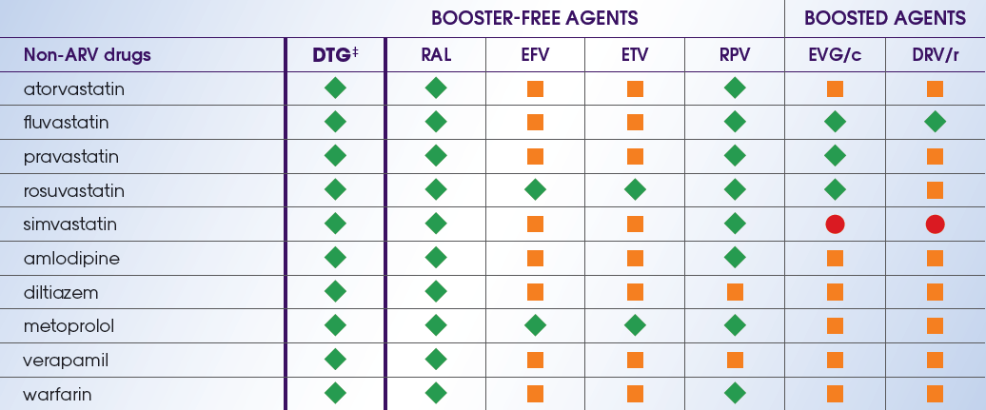
Dolutegravir-based regimens: booster-free with few significant interactions with commonly used medications
Selected cardiovascular drugs – Drug-drug interactions between ARVs and non-ARVs
Adapted from University of Liverpool. Drug interactions chart. June 2015. http://www.hiv-druginteractions.org. Accessed June, 2015.

Slide 29
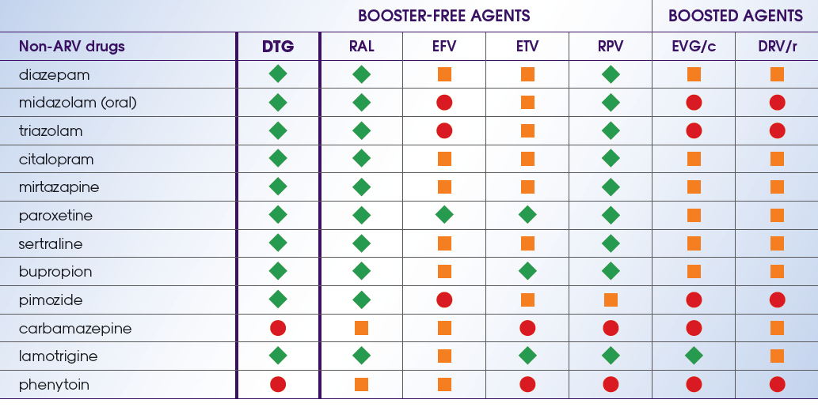
Dolutegravir-based regimens: booster-free with few significant interactions with commonly used medications
Selected CNS drugs – Drug-drug interactions between ARVs and non-ARVs
Adapted from University of Liverpool. Drug interactions chart. June 2015. http://www.hiv-druginteractions.org. Accessed June, 2015.

Slide 30
Dolutegravir-based regimens: booster-free with few significant interactions with commonly used medications
Selected anti-infective drugs – Drug-drug interactions between ARVs and non-ARVs
ª According to the Prezista® Summary of Product Characteristics, caution is warranted and clinical monitoring is recommended when co-administering darunavir/r and fluconazole.²
1. Adapted from University of Liverpool. Drug interactions chart. June 2015. http://www.hiv-druginteractions.org. Accessed June, 2015.
2. Prezista® Summary of Product Characteristics. November 2014

Slide 31
Dolutegravir-based regimens: booster-free with few significant interactions with commonly used medications
Selected HCV drugs – Drug-drug interactions between ARVs and non-ARVs
Adapted from University of Liverpool. Drug interactions chart. June 2015. http://www.hiv-druginteractions.org. Accessed June, 2015.

Slide 32
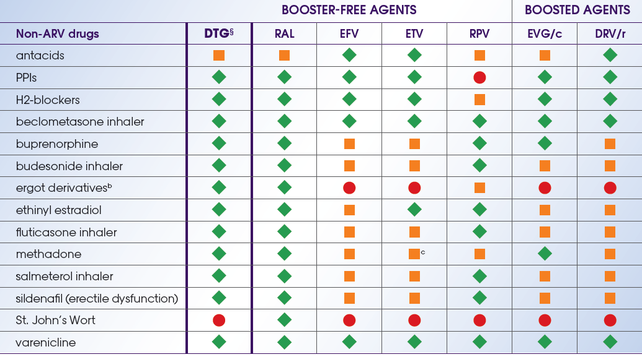
Dolutegravir-based regimens: booster-free with few significant interactions with commonly used medications
Selected miscellaneous drugs – Drug-drug interactions between ARVs and non-ARVs
b Ergot derivative interactions may vary with individual products and should be individually checked before prescribing.
c According to the Intelence® Summary of Product Characteristics, no changes in methadone dosage were required based on clinical status during or after the period of etravirine co-administration.2
§ Metformin concentrations may be increased by dolutegravir. Patients should be monitored during therapy and a dose adjustment of metformin may be required.
Adapted from University of Liverpool. Drug interactions chart. June 2015. http://www.hiv-druginteractions.org. Accessed June, 2015.
Intelence® Summary of Product Characteristics. November 2014

Slide 33
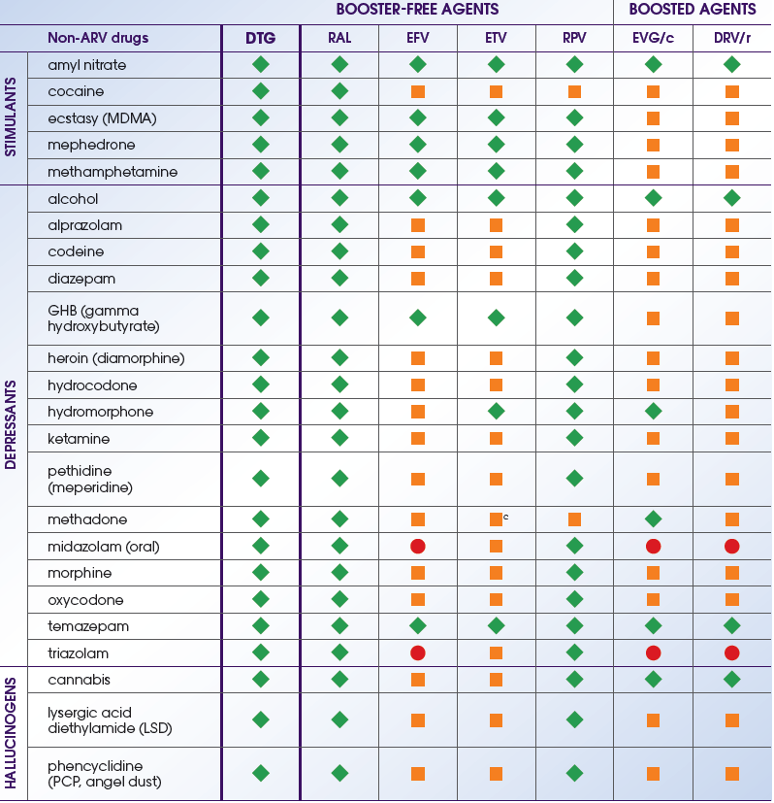
Dolutegravir-based regimens: booster-free with few significant interactions with commonly used medications
Selected recreational drugs – Drug-drug interactions between ARVs and non-ARVs
c. According to the Intelence® Summary of Product Characteristics, no changes in methadone dosage were
required based on clinical status during or after the period of etravirine co-administration.²
Adapted from University of Liverpool. Drug interactions chart. June 2015. http://www.hiv-druginteractions.org. Accessed June, 2015.
2. Intelence® Summary of Product Characteristics. November 2014

Slide 34
Key characteristics of DOLUTEGRAVIR-BASED REGIMENS
Superior efficacy in 3 out of 4 comparative studies^{1–4}
ü
Convenience beyond once-daily dosing⁵
ü
ü
Favourable tolerability profile^{7–9}
DOLUTEGRAVIR
Booster-free - few clinically significant drug interactions¹⁰
ü
ü
High barrier to resistance^{4–8}
Walmsley S et al. N Engl J Med 2013;369:1807–1818;
Clotet B et al. Lancet 2014;383:2222–223;
Cahn P et al. Lancet 2013;382:700–708;
Raffi F et al. Lancet Infect Dis 2013;13:927–935;
Tivicay Summary of Product Characteristics;
Pappa K et al. ICAAC 2014. Abstract H-647a;
Walmsley S et al. CROI 2014. Poster 543;
Molina J-M et al. Lancet HIV 2015;2:e127–e136;
Quercia R et al. Clin Drug Investig 2015;35:211–219
HIV drug interactions charts. Liverpool HIV Pharmacology Group (LHPG), University of Liverpool, UK. Available at http://www.hiv-druginteractions.org (accessed 20/02/2015)

Slide 35
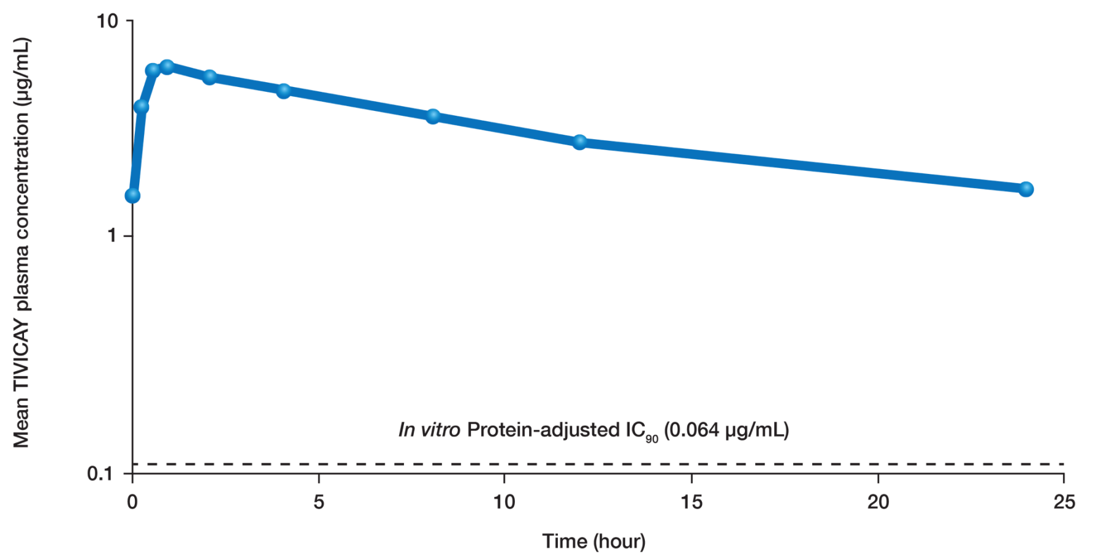
DOLUTEGRAVIR-BASED regimens had a predictable and consistent Pk profile
At steady state 24 hours post-DTG administration, plasma concentrations were 19 to 25 fold above IC₉₀
Van Lunzen J et al. Lancet Infect Dis 2012; 12(2):111-118
Min S et al. Antimicrob Agents Chemother. 2010; 54:254-258

Slide 36
Comparison of DOLUTEGRAVIR-BASED REGIMENS’ PK/PD profile with elvitegravir and raltegravir DEMONSTRATES CONVENIENCE
 | DTG | RAL | EVG
Clinical dose | 50 mg QD (INI-naïve), 50 mg BID (INI-resistant) | 400 mg BID | 150 mg QD boosted (quad pill)
t_{1/2} | ~14 hours | ~9 hours | ~12.9 hours (boosted)
PK variability | Low to moderate | High | Low (with boosting)
Food effect | Can be taken with or without food | No food restriction, but fat content affects absorption and increases PK variability | Taken with food
Protein binding | High: 99.5–99.7% | Moderate: 83% | High: 98–99%
Metabolism and excretion | UGT1A1 (major), CYP3A (minor), renal elimination <1% | UGT1A1, renal elimination ~9% | CYP3A (major), UGT1A1/3 (minor), renal elimination 6.7%
PK/PD relationship | Yes, C_{trough}-driven efficacy | No | Yes, C_{trough}-driven efficacy
TIVICAY (dolutegravir) Summary of Product Characteristics
Min S, et al. Antimicrob Agents Chemother 2010; 54:254–258 Min S, et al. AIDS 2011; 25:1737–1745
ISENTRESS (raltegravir) Summary of Product Characteristics
STRIBILD Summary of Product Characteristics
Ramanathan S, et al. Clin Pharmacokinet 2011; 50:229–244

Slide 37
DOLUTEGRAVIR-BASED REGIMENS can be taken with or without food*
Fasting
Low, moderate and high fat meals increased DTG † AUC_{0–∞} by 33%, 41% and 66%, respectively
Low fat
Moderate fat
High fat
PA-IC₉₀ 0.064 µg/mL**
The Administration with food increased DTG exposure, but this was not clinically significant and therefore dolutegravir-based regimens can be taken without regard to meals*
*In the presence of INI-class resistance, DTG should preferably be taken with food to enhance exposure (particularly in patients with Q148 mutations)
**PA-IC90 is the protein-adjusted 90% inhibitory concentration; † †Phase III (50 mg) formulation TIVICAY (dolutegravir) Summary of Product Characteristics
Adapted from Song I, et al. Antimicrob Agents Chemother 2012;56:1627–1629

Slide 38
SUMMARY
There is an increasing proportion of people living with HIV who are over 50¹
People living with HIV may be at increased risk of developing illnesses more commonly associated with more advanced age²
Age-related co-morbidities and their associated medications increase risks of drug interactions^{3,4}, side-effects^{3,4} and poor adherence³
DTG is not primarily metabolised by Cytochrome P450 and has few significant drug interactions – no drug interactions with statins or anti-hypertensives have been found to date^{5,6}
DTG is as well tolerated as raltegravir but in a once-daily formulation⁷⁻¹⁰
1. Mahy M et al. AIDS 2014; 28(Suppl 4): S453-459
2. Greene M et al. JAMA 2013;309:1397-1405
3. Edelman EJ et al. Drugs Aging 2013; 30: 613-628
4. Nachega JB et al. AIDS 2012; 26 (Suppl 1); S39-S53
5. Adapted from University of Liverpool. Drug interactions chart. June 2015. http://www.hiv-druginteractions.org. Accessed June, 2015.
6. TIVICAY (dolutegravir) Summary of Product Characteristics
7. Raffi F et al. IAS 2012. Abstract THLBB04
8. Raffi F et al. Lancet 2013; 381:735–743
9. Raffi F, et al. Lancet Infect Dis 2013; 13:927-935
10. Raffi F, et al. Lancet Infect Dis 2013; 13:927-35 (suppl appendix)

Slide 39
Building a regimen around dolutegravir FOR PATIENTS >50 years: Summary
Efficacy
Dolutegravir-based regimens show consistent efficacy in different subgroups
Drug resistance
Dolutegravir-based regimens have a high barrier to resistance
Tolerability
Dolutegravir-based regimens are generally well tolerated with few discontinuations
Booster-free
Dolutegravir-based regimens are booster-free and have few significant interactions with commonly used medications
Convenience
Dolutegravir-based regimens are convenient beyond once-daily dosing
Walmsley S, et al. N Engl J Med 2013; 369:1807-18
Walmsley S, et al. Poster presented at: 21st CROI 2014. Poster 543
Pappa K, et al. Presented at: 54th ICAAC 2014. H-647a
Raffi F et al. Lancet 2013;381:735–43 Raffi F, et al. Lancet Infect Dis 2013; 13:927-35
Clotet B, et al. Lancet 2014; 383: 2222-31
Molina J-M, et al. J Int AIDS Soc. 2014;17(suppl 3):19490
Cahn P, et al. Lancet 2013;382(9893):700-708

Slide 40
Prescribing Information Tivicay®▼ (dolutegravir 50mg tablets) (See Summary of Product Characteristics before prescribing)
Indication: HIV in >12 years and >40kg as part of combination therapy. Dosing: 50mg once daily with or without food if no proven/suspected integrase resistance. 50mg twice daily with efavirenz, nevirapine, tipranavir/ritonavir or rifampicin. Adults with proven/ suspected integrase resistance: 50mg twice daily preferably with food. Elderly: Limited data in 65+ yrs. Caution in severe hepatic impairment. Contraindications: Hypersensitivity to any ingredient. Co-administration with dofetilide Warnings/precautions: Risk of hypersensitivity reactions. Discontinue dolutegravir and other suspect agents immediately if suspected. Risks of osteonecrosis, immune reactivation syndrome. Monitor LFTs in Hepatitis B/C co-infection and ensure effective Hepatitis B therapy. Monitor with metformin. Use with etravirine requires boosted PI. Use with Mg/Al-containing antacids, calcium, multivitamins or iron requires dosage separation. Use with St John’s Wort and some anti- epileptic drugs not recommended. Pregnancy/ lactation:
Not recommended. Avoid breast-feeding. Side effects: See SPC for full details. Headache, GI disturbance, insomnia, abnormal dreams, depression, dizziness, rash, pruritus, fatigue, elevations of ALT, AST and CPK, hypersensitivity, suicidal ideation or suicide attempt. Basic NHS costs: 30 tablets £498.75 EU/1/13/892/001. MA holder: ViiV Healthcare UK Ltd, 980 Great West Road, Brentford, Middlesex TW8 9GS. Further information available from Customer Contact Centre, GlaxoSmithKline UK Ltd, Stockley Park West, Uxbridge, Middlesex UB11 1BT.
Tivicay is a registered trademark of the ViiV Healthcare Group of Companies
Date of approval: May 2015
Zinc code: UK/DLG/0055/13(6)
POM
Adverse events should be reported. For the UK, reporting forms and information can be found at www.mhra.gov.uk/yellowcard. Adverse events should also be reported to GlaxoSmithKline on 0800 221 441.
Adverse events should be reported. For Ireland, adverse events should be reported directly to the HPRA; Freepost, Pharmacovigilance Section, Health Products Regulatory Authority, Earlsfort Terrace, Dublin 2, Tel: +353 1 676 4971, medsafety@hpra.ie. Adverse events should also be reported to GlaxoSmithKline on 1800 244 255.

Slide 41
Prescribing Information Triumeq®▼(dolutegravir 50mg/abacavir 600mg/lamivudine 300mg tablets) (See Summary of Product Characteristics before prescribing)
Indication: HIV in over 12 years and > 40kg. Screen for HLA-B*5701 prior to use. Do not use if HLA-B*5701 positive. Dose: one tablet once daily with or without food. Elderly: Limited data in 65+ yrs. Creatinine clearance <50ml/min or moderate/severe hepatic impairment: Not recommended. Contraindications: Hypersensitivity to any ingredient. Co-administration with dofetilide. Warnings/precautions: Both abacavir and dolutegravir are associated with risk of hypersensitivity reactions (HSR). Do not initiate in HLA-B*5701+ or previous suspected abacavir HSR. Stop Triumeq without delay if HSR suspected. Never reintroduce any dolutegravir- or abacavir-containing product after suspected HSR. Risks of lactic acidosis, lipodystrophy, immune reactivation syndrome, osteonecrosis. Monitor LFTs in Hepatitis B/C co-infection. Inconclusive data on relationship between abacavir and MI; minimise all modifiable CV risk factors (e.g. smoking, hypertension, hyperlipidaemia). Not recommended if dolutegravir required b.d. Use with cladribine, emtricitabine, enzyme inducers e.g. anticonvulsants, St John’s Wort, not recommended. Use with etravirine requires boosted PI. Use with Mg/Al-
containing antacids, calcium, multivitamins or iron requires dosage separation. Caution with ribavirin, metformin. Pregnancy/lactation: Not recommended. Avoid breast-feeding. Side effects: See SPC for details. Headache, insomnia, sleep/dream disorders, GI disturbance, fatigue, hypersensitivity, anorexia, depression, dizziness, somnolence, lethargy, malaise, cough, nasal symptoms, rash, pruritus, alopecia, arthralgia, muscle disorders, asthenia, fever, elevations of ALT, AST and CPK, blood dyscrasias, rhabdomyolysis, erythema multiforme, Stevens-Johnson syndrome, toxic epidermal necrolysis. Basic NHS costs: 30 tablets: £798.16 EU/1/14/940/001. MA holder: ViiV Healthcare UK Ltd, 980 Great West Road, Brentford, Middlesex TW8 9GS. Further information is available from Customer Contact Centre, GlaxoSmithKline UK Ltd, Stockley Park West, Uxbridge, Middlesex UB11 1BT.
Triumeq is a registered trademark of the ViiV Healthcare Group of Companies
Date of approval: November 2014 Zinc code: UK/TRIM/0037/14(2)
POM
Adverse events should be reported. For the UK, reporting forms and information can be found at www.mhra.gov.uk/yellowcard. Adverse events should also be reported to GlaxoSmithKline on 0800 221 441.
Adverse events should be reported. For Ireland, adverse events should be reported directly to the HPRA; Freepost, Pharmacovigilance Section, Health Products Regulatory Authority, Earlsfort Terrace, Dublin 2, Tel: +353 1 676 4971, medsafety@hpra.ie. Adverse events should also be reported to GlaxoSmithKline on 1800 244 255.

